Slide 1


Town of Cobourg
Strategic Planning Report
October 16th, 2023

Slide 2
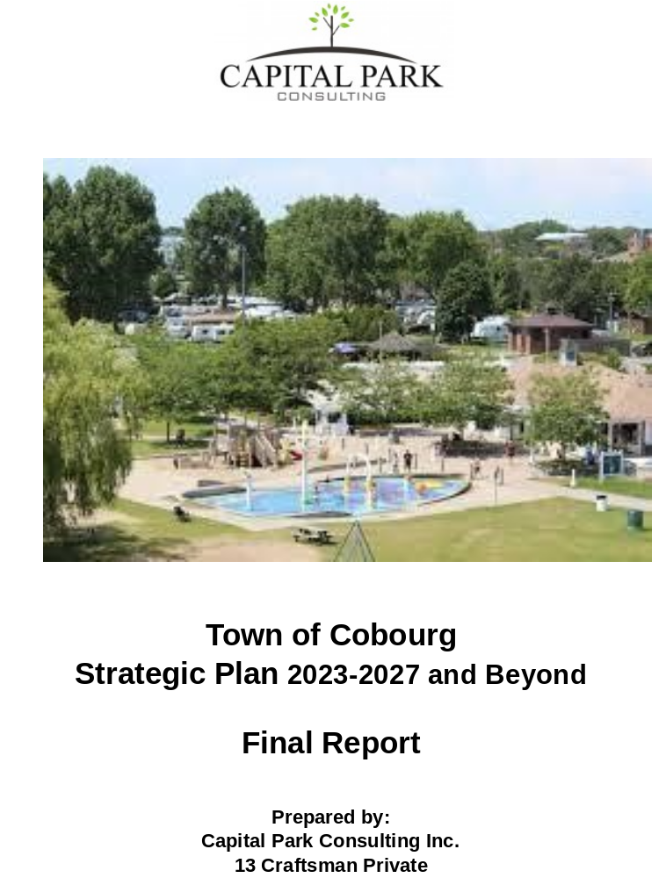
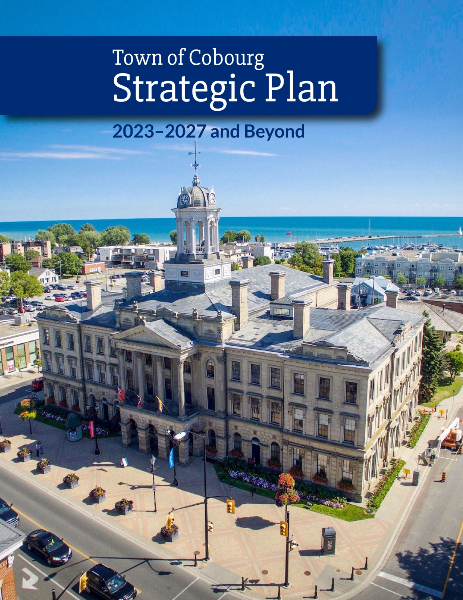
Two Documents

Slide 3
Final Report
Contents
Purpose
Document Review and Research Findings (a.k.a. PESTEL Analysis, a.k.a. Environmental Scan)
Stakeholder Engagement Activities
Summary of Planning Workshop
Summary of Further Consultations Between Senior Staff and Capital Park
Consolidates all information into one document
Provides full transparency to residents and other stakeholders about the project
Resource material for current and future staff
Resource material for current and future members of Council

Slide 4
Strategic Plan – Vision Statement
What makes a great Vision Statement?
Articulates the ideal future position, dream, grand purpose
Succinct and easily understood, remembered
Broad – covers all perspectives
Inspiring and uplifting
Requires “big thinking” – beyond what we can easily achieve
Cobourg Vision Statement:
Welcoming community;
thriving town

Slide 5
Strategic Plan – Mission Statement
What makes a great Mission Statement?
Describes what the organization wants to do and why
Outcome oriented
Inclusive and broad enough to be relevant to all constituents
Inspiring and uplifting message from Cobourg’s decision makers to all stakeholders
As succinct as possible (fit it on a t-shirt?) – not always possible
Cobourg Mission Statement:
Exceeding expectations through quality experiences

Slide 6
Strategic Priorities
Thriving Town
Service Excellence
Sustainability

Slide 7
Thriving Town
Strategic Actions
Strategic Questions
Provide infrastructure to support a healthy community that will enable each of us to flourish and reach our full potential
Institute development policies that promote the provision of a mixture of housing options that support the community
Invest in programs, services and infrastructure that encourage healthy lifestyles for all age groups
Maintain resiliency and competitiveness through investments in people and resources in collaboration with other public sector agencies and levels of government
Does this foster community wellbeing?
Does it give us more to do and a place for all to enjoy?
Does this encourage appropriate growth and development?
Does this support a complete community where people can live, work, shop and access services in close proximity?

Slide 8
Service Excellence
Strategic Actions
Strategic Questions
Assess points of contact with customers to identify ways to streamline communications, increase stakeholder engagement, demonstrate user friendliness and provide optimal service
Embrace new technologies that will improve customer service and increase efficiency and accessibility
Ensure that human resources policies and practices make Cobourg the employer of choice to attract and retain the best talent
Develop and implement Key Performance Indicators and Continuous Improvement Plans for municipal programs and services to measure Customer Satisfaction, Community Impact and Efficiency
Is this improving service for residents and customers?
Is it making best use of technology?
Is it making it easier for residents to access the services they need and want?
Is this making us more inclusive, equitable and accessible?
Is this building our capacity to deliver?

Slide 9
Sustainability
Strategic Actions
Strategic Questions
Preserve and promote the heritage, history and culture of Cobourg to sustain it as a vibrant and appealing destination
Protect Cobourg’s harbour and waterfront for use and enjoyment by residents, visitors and future generations
Take a community approach to making the future of Cobourg equitable, resilient, and sustainable in response to our ever changing natural environment , including efforts to address climate change
Enhance our Financial and Asset Management Plans to provide appropriate levels of services and ensure long-term sustainability
Is this taking care of what we have in ways that are adaptive, resilient, clean, green and beautiful?
Is it affordable now and in the long term?
Does this further our commitments to environmental leadership?
Have we considered the opportunity cost as well as the financial cost?

Slide 10
Other Features
“How We Will Implement this Plan”
“Strategic Planning Context” (Other Plans and Policies)
“Message from the Mayor and Council”
“Message from the CAO and Senior Leadership Team”
Accessible format

Slide 11

Thank you for your attention.
Are there any questions?

