Slide 1
Cobourg Waterfront Boardwalk Replacement
Public Consultation
May 31, 2023

Slide 2
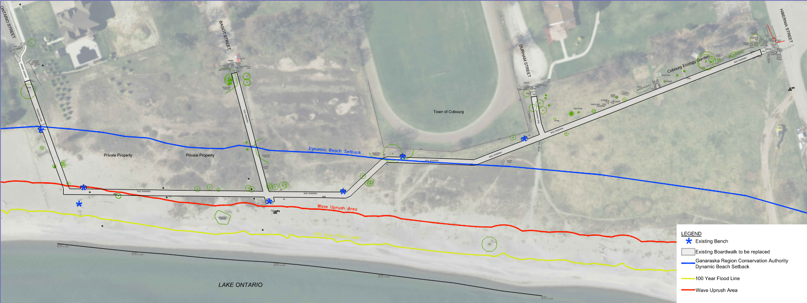
Project Area
The project area includes the wood boardwalk from Ontario Street to Hibernia Street, including north-south connections to Ontario Street, Bagot Street, and Durham Street.
Dynamic Beach Setback
Wave Uprush Area
100-Year Flood Line

Slide 3
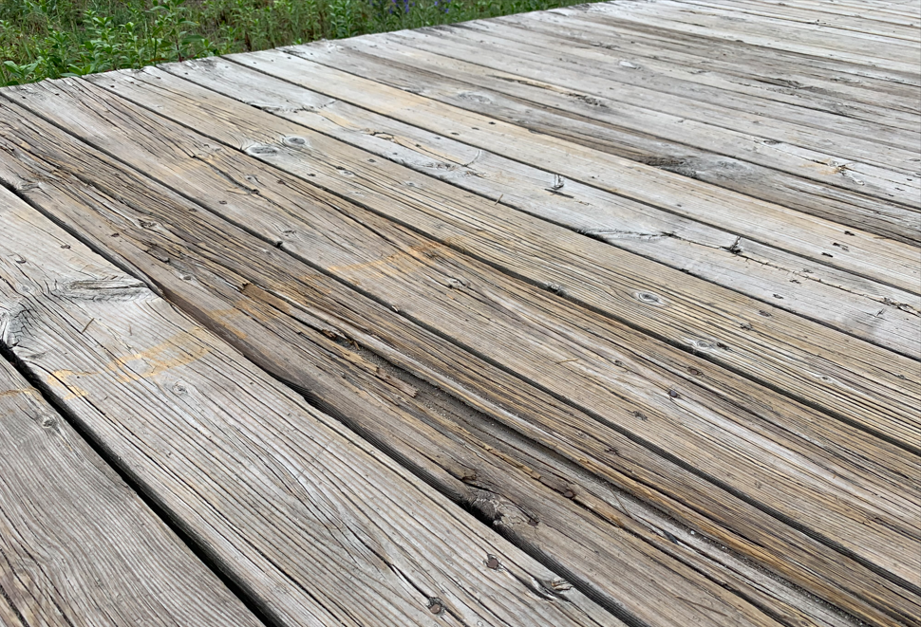
Project Background
Public Works regularly inspects the boardwalk for deficiencies and has found that the boardwalk structure and decking is severely rotted throughout its length. Opportunities for extending the life of the boardwalk are limited and may not even be possible due to the poor condition of the wood substructure underneath the surface deck boards.
During 2021 budget deliberations, Council approved budget for the design of the boardwalk replacement for 2022 construction.
The project was postponed in 2022 while the Town was in negotiations to purchase the school board property west of Durham Street in order to secure ownership of the lands where the boardwalk currently exists across an easement.
Deteriorating condition of boardwalk

Slide 4
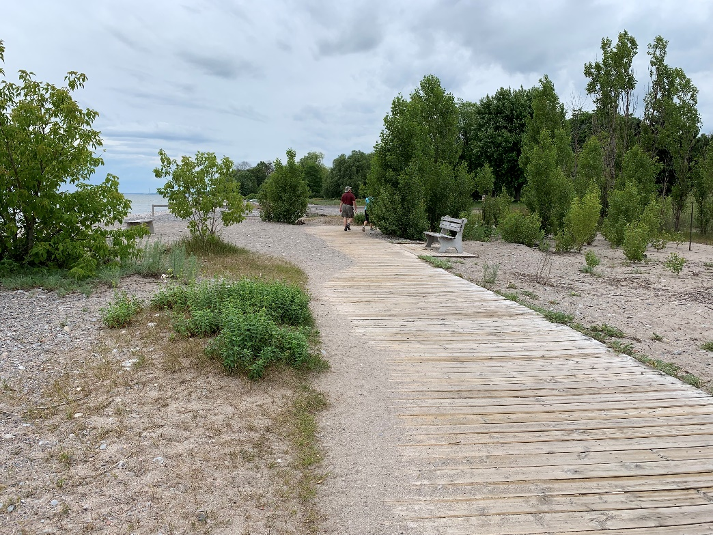
Boardwalk Information
The boardwalk was constructed over 15 years ago using pressure treated wood
The sleeper/stringer substructure supporting the boardwalk was constructed on the sand surface
The boardwalk is at the end of its service life – the sleeper/stringer system is severely rotted
Significant ongoing maintenance requirements
Safety concerns caused by rotting surface boards and exposed nails
The new boardwalk must be built generally in the same location due to property restrictions, to avoid new impacts to the dynamic beach area, and to minimize damage to the existing vegetation.
Sand blows onto west end of boardwalk
Notes:
The wood boardwalk was constructed over 15 years ago and it is now at the end of its service life. The wood frame of the boardwalk is sitting on sand, and the boardwalk is continually exposed to rain, snow, ice, blowing sand, sun, and wind. As the condition of the wood has deteriorated, there have been significant ongoing maintenance requirements to minimize safety concerns caused by rotting surface boards and exposed nails. Boards have been replaced in several locations, but the sleeper/stringer system supporting the boardwalk surface is rotting, so it is difficult to secure new boards. Repair work required is labour intensive because vehicles and machinery cannot be driven on the boardwalk. The materials and tools required for repairs must be transported on a hand operated trailer/dolly.
The new boardwalk must be built generally in the same location due to property restrictions, and to minimize damage to the existing vegetation along the beach.

Slide 5
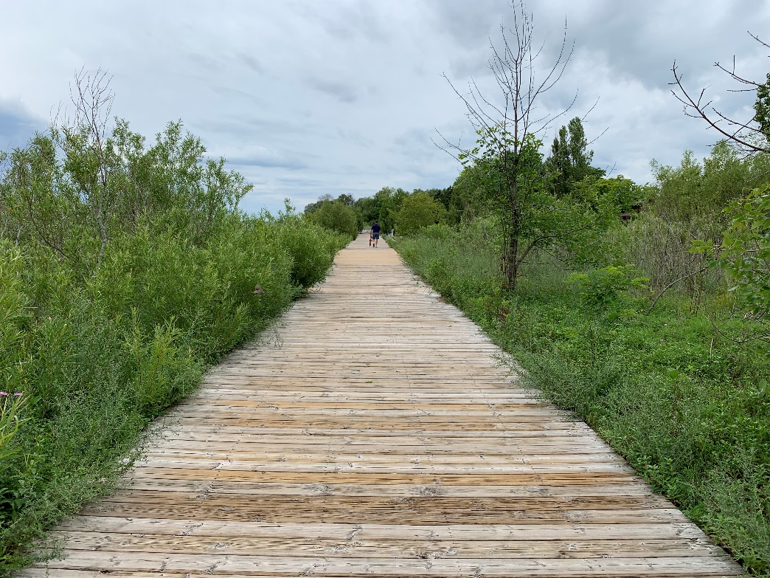
Boardwalk Information
Concerns about insufficient boardwalk width have been expressed by:
Members of the public
Accessibility Advisory Committee
Transportation Advisory Committee
Local cyclists
According to Ontario Traffic Manual Book 18: Cycling Facilities:
Suggested minimum width for multi-use paths is 3m
Desired width is 4 m where possible
The current boardwalk is 3 m wide and in some locations, within a 5m easement.
Vegetation encroachment narrows the usable width of the boardwalk in some areas
Notes:
Town staff have received comments from the public, the Accessibility Advisory Committee, the Transportation Advisory Committee, and local cyclists stating that the boardwalk is too narrow for all the activities it is being used for such as cycling and mobility aids. Ontario Traffic Manual Book 18: Cycling Facilities notes that the suggested minimum width for multi-use paths is 3 m, and the desired width is 4 m where possible. The current boardwalk is 3 m wide, located within a 5 m easement. Vegetation that has grown adjacent to the boardwalk is encroaching on the usable width of the boardwalk surface in some areas.

Slide 6
Project Area – Natural conditions
  In past studies of the natural areas of the Lake Ontario shoreline (for example, V.R. Brownell, Natural Areas along the Lake Ontario Waterfront from Newcastle to Trenton, August 1993), the section of beach area where the boardwalk is located was recognized as a good representation of regionally rare Lake Ontario beaches, and it is the largest natural Shoreline Beach community along the eastern portion of the Waterfront apart from Presqu’ile Provincial Park.
  Willow Beach Field Naturalists have acknowledged the west beach area as an important location for shorebird migration, and recognize that the boardwalk helps to protect the beach by keeping the majority of pedestrian and cyclist traffic within a dedicated area.
Notes:
The Brownell document also acknowledges the importance of having natural areas available for the public to enjoy.

Slide 7
Work to date
  A Natural Heritage Report was completed by Beacon Environmental for the Boardwalk Replacement
  Information provided includes inventory of existing vegetation , breeding birds, and screening for Species At Risk
  No endangered or threatened species were present in the vicinity of the boardwalk.
  The mitigation and enhancement recommendations in Beacon’s report will be considered during detailed design of the boardwalk, including:
    Planting of native herbaceous species to restore disturbed edges along new boardwalk construction
  A geotechnical investigation has been completed to determine subsurface conditions along the boardwalk area.
  This information was considered in determining the materials and methods required for design options of the replacement boardwalk
  Construction materials and methods have been investigated to provide cost estimates
Notes:
The Parks and Recreation Advisory Committee requested that a Natural Systems Stewardship Plan be prepared prior to the design of the boardwalk replacement.
Beacon Environmental was retained to complete a natural heritage assessment, including inventory of existing vegetation , breeding birds, and screening for Species At Risk. The scope of work includes the west headlands area and the beach area south of the boardwalk, to understand the potential impacts of the boardwalk replacement within the context of the larger area. A separate natural heritage report is being completed for the west headlands and beach to document the natural environment features for those areas. The report provides information about sensitive environmental features, and it includes mitigation measures and stewardship recommendations to assist with future projects that are recommended in the Waterfront User Needs Assessment.
In the interest of moving ahead with the boardwalk replacement in a timely manner, the natural features associated with the boardwalk were documented separately from the west headlands and beach area. No endangered or threatened species were present in the vicinity of the boardwalk. The mitigation and enhancement recommendations in Beacon’s report will be considered during detailed design of the boardwalk.
A geotechnical investigation has been completed to determine subsurface conditions along the boardwalk area. This information is being considered in determining the materials and methods required for design of the new path.

Slide 8
Work to date
  Shoreplan Engineering Limited completed a wave uprush analysis for the boardwalk area west of Bagot Street. The results indicate that waves will reach the boardwalk area, with the wave run-up elevation estimated to be 76.6 to 76.9.
  The report acknowledged that the profile of the beach will be altered during storm events, and the beach profile could be eroded at least 0.5m below the present profile at the boardwalk location (dynamic beach).
  The report suggests that in order to design the boardwalk to be resilient to high water levels and wave uprush, the underside of the boardwalk should be no lower than 76.5m and the top of the boardwalk could be as high as 77.0m, supported on helical piles.
  Conceptual design of the Elevated Option for the area within the Dynamic Beach Area includes construction on helical piles with a surface elevation of 77.0m

Slide 9
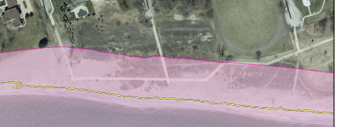


Ganaraska Region Conservation Authority (GRCA) Lake Ontario Shoreline Management Plan Hazard Mapping
Dynamic Beach Setback
The dynamic beach setback is determined by the 100-year flood level, plus an allowance for wave uprush and a 30 m allowance to account for the dynamic nature of the beach.
Lake Ontario Shoreline Management Plan.pdf

Slide 10
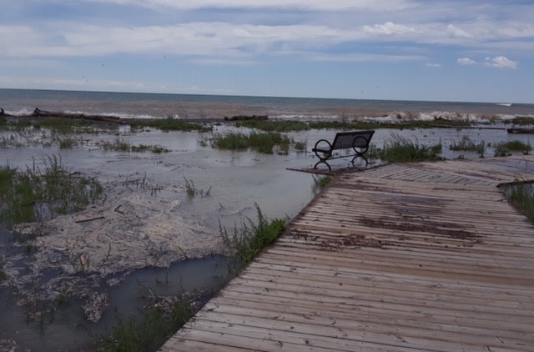
Lake Ontario Shoreline Management Plan (November 5, 2020, Zuzek inc.)
Ganaraska Region Conservation Authority (GRCA) Lake Ontario Shoreline Management Plan Hazard Mapping
  Arrow indicates location of photo showing 2019 high water levels of west beach (also occurred in 2017).
  To avoid risk of high water damage, a higher elevation is being considered for the portions of the replacement boardwalk that fall within the Dynamic Beach Setback.

Slide 11
Summary of Option Combinations and Costs
West portion (300m)
Within Dynamic Beach Setback
East portion (275m)
Outside Dynamic Beach Setback
Approx. Initial Capital Cost
Replace Similar to Existing
Minimally elevated on deck blocks or sleepers
Widened 4.0m pressure treated wood deck w/curb
Replace Similar to Existing
Minimally elevated on deck blocks or sleepers
Widened 4.0m pressure treated wood deck w/curb
$870,000
1
Asphalt At Grade
4m wide asphalt surface
$1,010,000
2
Elevated - Wood
4m wide with pressure treated wood deck on helical piles
Wood and wire mesh railing
Concrete At Grade
4m wide concrete surface
$1,155,000
3
Elevated - Composite
4m wide with composite deck on helical piles
Pre-fabricated steel or aluminium handrail
Asphalt At Grade
4m wide asphalt surface
$1,170,000
4
Concrete At Grade
4m wide concrete surface
$1,315,000
5
Approximate Capital Costs include amenities and other additional project costs in addition to per m cost of initial construction

Slide 12
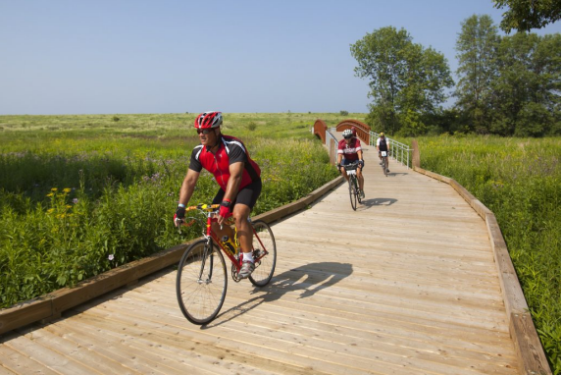
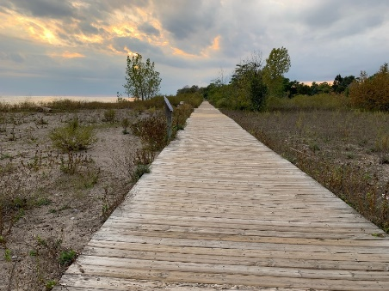
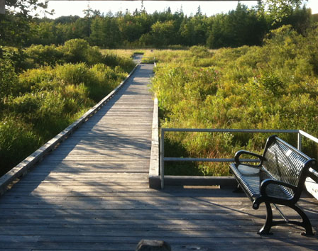
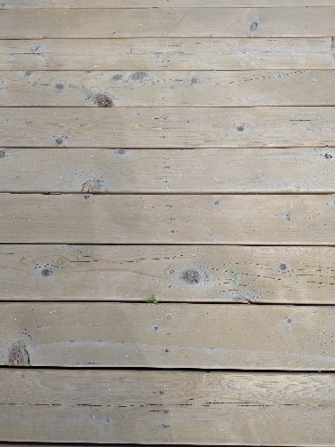
Option Replace Similar to Existing
1
Replace wood boardwalk as is, constructed on beach surface
Widened from 3m to 4m, curb edge added for accessibility
Familiar, rustic material
Short service life, higher maintenance to ensure safety
Estimated Capital Cost $870k
1
Existing boardwalk is approximately 100mm-150mm (4-6”) above ground level
Notes:
The first option is to replace the entire boardwalk close to grade (same as existing), on the surface of the beach…
Within the dynamic beach area, it is expected that the boardwalk will be impacted by high water levels and blowing sand, and that it will require more frequent repairs and replacement.

Slide 13
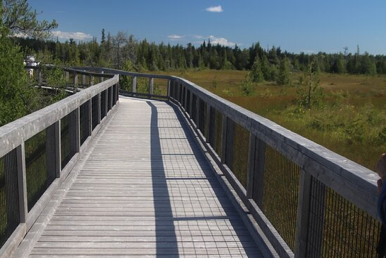
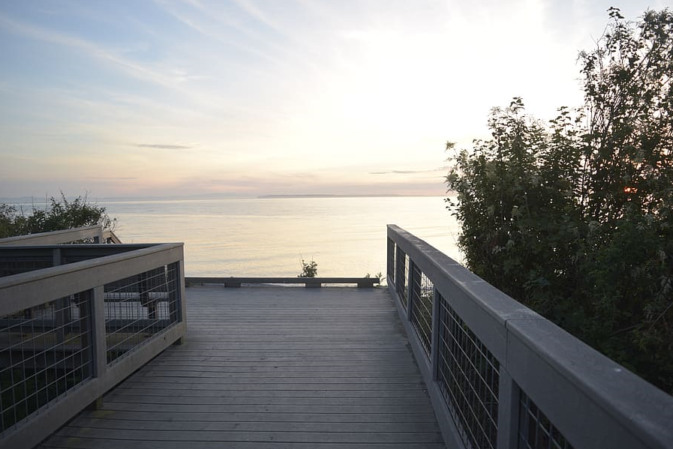
Option and for West Portion of Boardwalk
2
3
Elevated wood decking material boardwalk on helical piles
Widened from 3m to 4m, with wood railings
Familiar, rustic material; improved service life
Focuses beach access points to minimize foot traffic impact to beach environment
Estimated Capital Cost:
  $1.01M with asphalt connections (see Option 2)
  $1.155M with concrete connections (see Option 3)
2
3
Notes:
For the west portion of the boardwalk that is within the Dynamic Beach Area, the boardwalk can be constructed on footings to raise the surface of the path above the level where it could be affected by fluctuating water levels and wave uprush. This would result in higher upfront installation cost, but lower maintenance requirements and longer service life. Because the surface would be above the beach surface, railings would be required along the path edges.
These images show a Wood material option, with wood railing and wire mesh to keep views open.

Slide 14
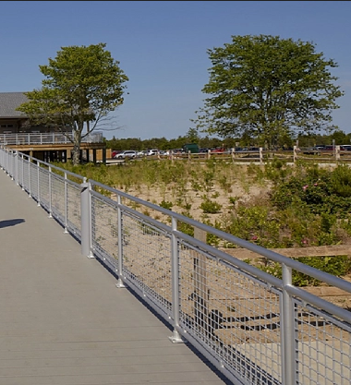
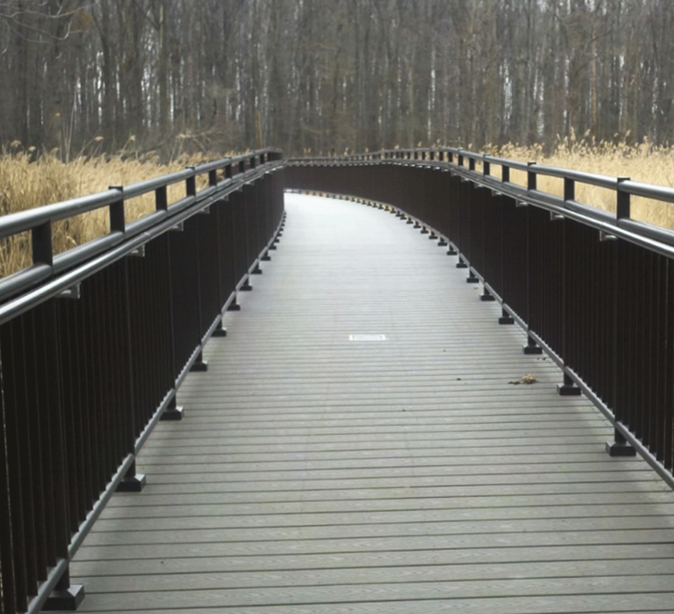
Options and for West Portion of Boardwalk
4
5
Elevated composite decking material boardwalk on helical piles
Widened from 3m to 4m, with metal railings
Long service life
Focuses beach access points to minimize foot traffic impact to beach environment
Estimated Capital Cost:
  $1.170M with asphalt connections (See Option 4)
  $1.315M with concrete connections (See Option 5)
4
5
Notes:
The second material option being considered for raised boardwalk is composite decking with a metal railing system.

Slide 15
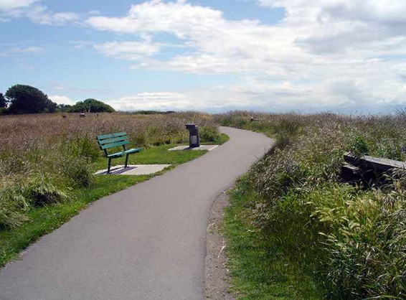
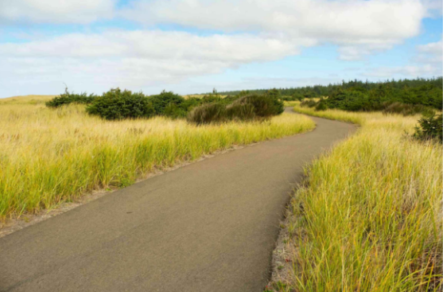
Option and for East Portion of Boardwalk
2
4
The at-grade portions of the walkway constructed using asphalt
Example of an asphalt pathway with a mowed strip
Example of an asphalt pathway with naturalized edge

Slide 16
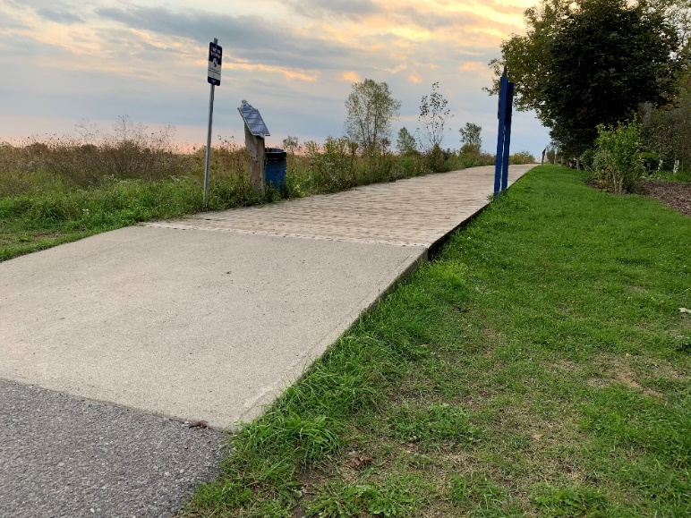
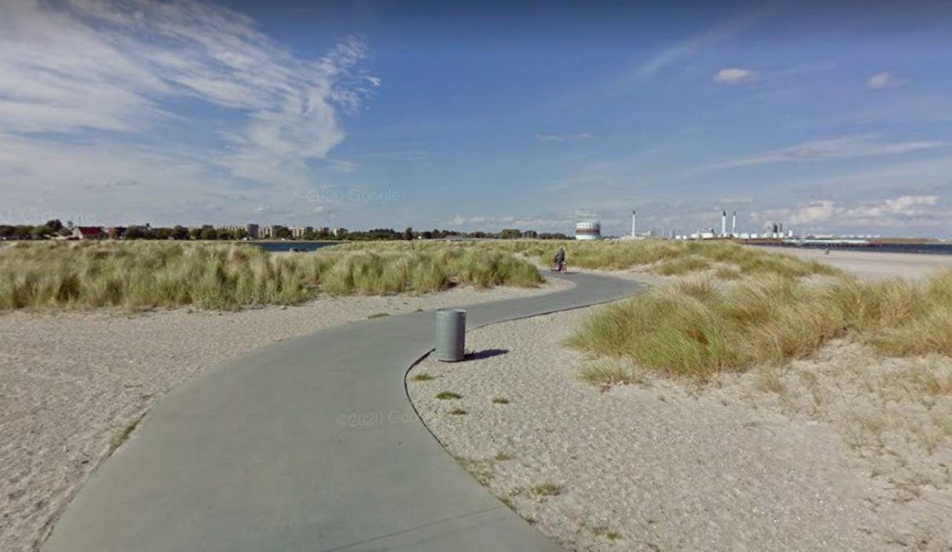
3
5
Option and for East Portion of Boardwalk
The at-grade portions of the walkway constructed using concrete
Concrete path transition at east end of existing wood boardwalk
Example of concrete path along beach area

Slide 17
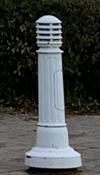
Boardwalk Options – Additional Amenities:
  Lighting (pedestrian-scale bollards) could be included along the north side of the path, with light directed south towards the path. Lighting costs have not been included in the cost estimate. It is expected that lighting would be approximately $300,000.
  Additional benches
  Waste receptacles will continue to be provided at the ends of the connecting streets where maintenance vehicles can easily reach them.
Example of bollard light
Notes:
Beacon’s report notes that lighting can be detrimental to birds when there are windows nearby that can cause birds to hit windows because of reflection. In this location there are no windows close enough to cause this concern.

Slide 18
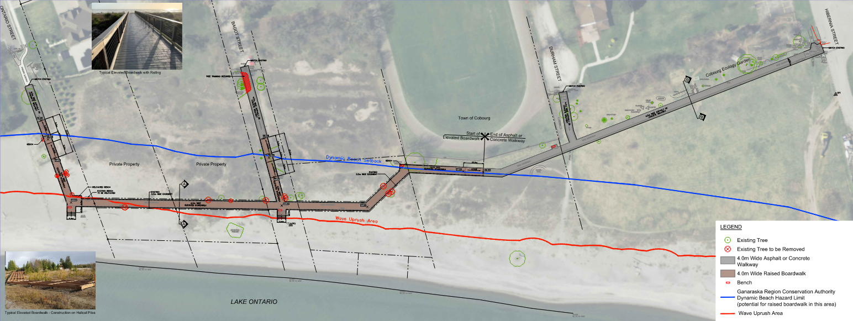
Conceptual Design of Elevated Boardwalk in combination with at-grade Boardwalk / Path

Slide 19
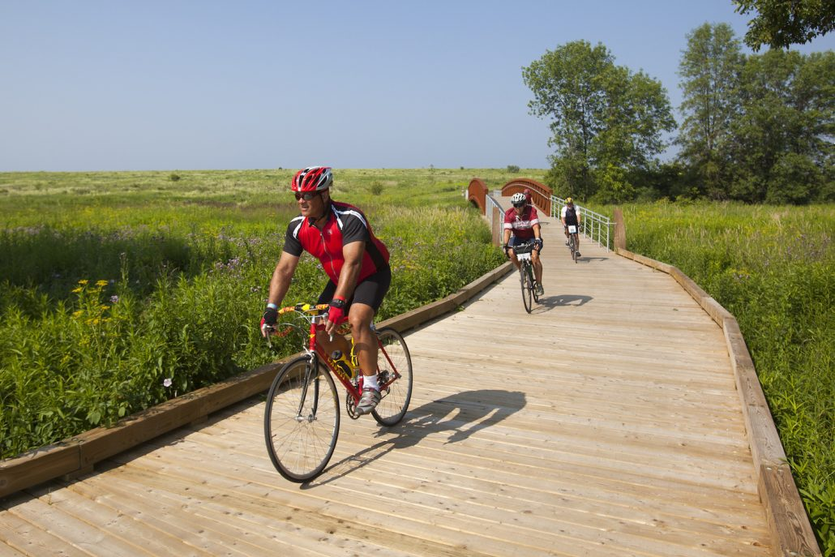
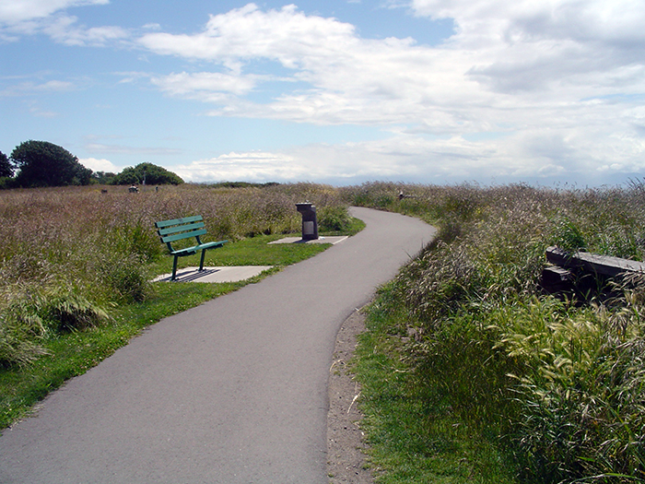
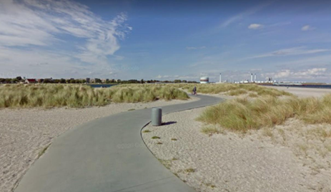
Lifecycle Costs - Options for East Portion (Outside of Dynamic Beach Area)
Decking & Sub-structure Repairs
$1,370/m
Decking Repairs
Wood Close to Grade
$$$
$$$
$$$
$$$
$$$
$
$$
$
$$
$
$$
$
$$
$
$$
15
Years
Full Replacement
Full Replacement
Full Replacement
Full Replacement
Full Replacement
Asphalt
$880/m
Surface/Edge Patching
40
$$
$$
$$
$$$
$
$
$
$
$
$
$
$
$
Years
Crack Sealing
Replace Asphalt Surface
Replace Asphalt Surface
Replace Asphalt & Repair Base
Full Replacement
Concrete
$1,410/m
$$
$$
$$$
75
Surface Repairs
$
$
$
Years
Spot Replacement & Mud Jacking
Spot Replacement & Mud Jacking
Full Replacement
1
5
10
15
20
25
30
35
40
45
50
55
60
65
70
75
Time Increments (Years)

Slide 20
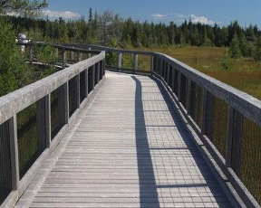
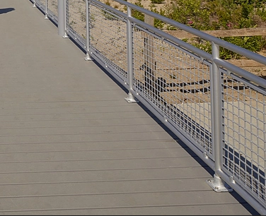
Lifecycle Costs - Options for West Portion (Within Dynamic Beach Area)
Decking & Sub-structure Repairs
$1,370/m
Decking Repairs
Wood Close to Grade
$$$
$$$
$$$
$$$
$$$
$
$$
$
$$
$
$$
$
$$
$
$$
15
Full Replacement
Full Replacement
Full Replacement
Full Replacement
Full Replacement
Elevated with Wood Decking
$2,260/m
Decking Repairs
20
40
$$
$$
$$
$$$
$
$
$
$
$
$
$
$
$
$
$
$
Years
(Deck)
Years
(Substructure)
Deck Replacement
Deck, Railing and Substructure Replacement
Deck Replacement
Full Replacement
Composite with Metal railing
$2,830/m
$$
$$$
40
$
$
$
$
$
$
Deck, Railing and Substructure Replacement
Full Replacement
Years
Decking Repairs
1
5
10
15
20
25
30
35
40
45
50
55
60
65
70
75
Time Increments (Years)

Slide 21
Lifecycle Cost Comparison for 1m Length of Each Material
Options for East Portion (Outside of Dynamic Beach Area) | Initial Cost (In 2023 dollars per metre) | Lifecycle | Lifecycle Costs Over 75 years (In 2023 dollars per metre) | Total Investment Over 75 years (In dollars per metre)
Wood Close to Grade (4m wide) | $1,370/m | 15 years | $6,000/m | $7,370/m (2023$)
Asphalt (4m wide) | $880/m | 40 years – surface 75 years – base | $920/m | $1,800/m (2023$)
Concrete (4m wide) | $1,410/m | 75 years | $490/m | $1,900/m (2023$)
Options for West Portion (Within Dynamic Beach Area) | Initial Cost (In 2023 dollars per metre) | Lifecycle | Lifecycle Costs Over 75 years (In 2023 dollars per metre) | Total Investment Over 75 years (In dollars per metre)
Elevated with Wood Decking and Wire Mesh Railing (4m wide) | $2,260/m | 20 years – decking 40 years – sub-structure 75 years – foundation | $2,640/m | $4,900/m (2023$)
Elevated with Composite Decking and Metal Railing (4m wide) | $2,830/m | 20 years – decking 40 years – sub-structure 75 years – foundations | $2,020/m | $4,850/m (2023$)
Total Investment = Initial Construction + Lifecycle Costs
Initial Cost Includes: Construction + Design + Contingency + General Items (i.e. Removals, Restoration, Access, Temporary Fencing, Sediment Control, etc.); does not include amenities and other minor project costs

Slide 22
Lifecycle Cost Comparison over 75 years for Each Option
 | West Portion Options (300m) (Outside Dynamic Beach Area) | West Portion Options (300m) |  | East Portion Options (275m) (Outside Dynamic Beach Area) | East Portion Options (275m) |  | Total Investment Cost Over 75 Years
 | Wood Close to Grade | Elevated with Wood Decking and Wire Mesh Railing | Elevated with Composite Decking and Metal Railing | Wood Close to Grade | Asphalt | Concrete
Initial Construction Costs | $1,370/m | $2,260/m | $2,830/m | $1,370/m | $880/m | $1,410/m
Lifecyle Costs (See Previous Pages) | $6,000/m | $2,640/m | $2,020/m | $6,000/m | $920/m | $490/m
Total Investment Over 75-years | $7,370/m | $4,900/m | $4,850/m | $7,370/m | $1,800/m | $1,900/m
Option 1 | 300m x $7,370 $2,211,000 |  |  | 275m x $7,370 $2,026,750 |  |  | $4,237,750
Option 2 |  | 300m x $4,900 $1,470,000 |  |  | 275m x $1,800 $495,000 |  | $1,965,000
Option 3 |  | 300m x $4,900 $1,470,000 |  |  |  | 275m x $1,900 $522,500 | $1,992,500
Option 4 |  |  | 300m x $4,850 $1,455,000 |  | 275m x $1,800 $495,000 |  | $1,950,000
Option 5 |  |  | 300m x $4,850 $1,455,000 |  |  | 275m x $1,900 $522,500 | $1,977,500
Total Investment = Initial Construction + Lifecycle Costs
Initial Construction Cost Includes: Construction + Design + Contingency + General Items (i.e. Removals, Restoration, Access, Temporary Fencing, Sediment Control, etc.); does not include amenities and other minor project costs

Slide 23
Project Summary
The existing boardwalk is in poor condition and must be replaced.
Detailed design will proceed following public consultation, with removal and reconstruction of the boardwalk planned in the fall of 2023 / spring of 2024.
The location of the boardwalk will remain the same to stay within existing easements and to limit disturbance to existing vegetation
Maintenance service levels will remain the same (summer only)
$450,000 of the project will be funded by the Active Transportation Fund and the balance will be debentured
Planned changes for the reconstructed boardwalk:
Widen from 3m to 4m
Accessible curbing added to all wooden options that do not require railings
Railings added where elevated options are 0.6m above ground level as required by Ontario Building Code
Area outside of the dynamic beach setback to be constructed at grade (wood, asphalt, or concrete)
Notes:
Minimal change if reconstructed as-is, with no obstruction from railings
Cons include: Prone to flooding and sand deposition
Vegetation will continue to narrow the usable width
High maintenance
Low service life
If raised boardwalk proceeds:
Longer service life
Lower long-term cost
Reduced maintenance
Railings limit beach disturbance to specific areas
Allows for dynamic beach processes to occur unimpeded by boardwalk structure
Railings could be viewed as confining

Slide 24
Decision to be made
East Portion (Outside of Dynamic Beach Area):
Replace with wood at ground level (similar to existing, with addition of wood curb), OR
Replace with asphalt path at ground level, OR
Replace with concrete path at ground level
Notes:
Minimal change if reconstructed as-is, with no obstruction from railings
Cons include: Prone to flooding and sand deposition
Vegetation will continue to narrow the usable width
High maintenance
Low service life
If raised boardwalk proceeds:
Longer service life
Lower long-term cost
Reduced maintenance
Railings limit beach disturbance to specific areas
Allows for dynamic beach processes to occur unimpeded by boardwalk structure
Railings could be viewed as confining

Slide 25
Decision to be made
West Portion (Within Dynamic Beach Area):
Replace with wood at ground level (similar to existing, with addition of wood curb), OR
Replace with wood at raised level (with wood railings) to protect the boardwalk from the impacts of dynamic beach processes, OR
Replace with composite at raised level (with metal railings) to protect the boardwalk from the impacts of dynamic beach processes
Notes:
Minimal change if reconstructed as-is, with no obstruction from railings
Cons include: Prone to flooding and sand deposition
Vegetation will continue to narrow the usable width
High maintenance
Low service life
If raised boardwalk proceeds:
Longer service life
Lower long-term cost
Reduced maintenance
Railings limit beach disturbance to specific areas
Allows for dynamic beach processes to occur unimpeded by boardwalk structure
Railings could be viewed as confining

Slide 26
